Slide 1


Unlocking the Power of Python
Embark on a journey to explore Python's versatility. Discover its core features and widespread applications. Learn why it's a top choice for developers worldwide.
by Amritha A

Slide 2




Understanding Programming Languages
Formal Language
Human-Machine Communication
Abstraction & Automation
Specifies instructions for computers.
Automates complex tasks.
Enables humans to instruct machines.
A programming language is a formal way to instruct computers. It enables humans to automate processes. It turns ideas into executable code.

Slide 3

A Brief History of Python
Monty Python
Design Philosophy
Named after the British comedy group, Python emphasizes readability.
Focuses on code readability and concise syntax.
Guido van Rossum
Created Python, releasing it in 1991.
Python was created by Guido van Rossum. Its design emphasizes readability and a clean syntax.

Slide 4

The Rising Popularity of Python
1
Simple Syntax
Easy to learn, beginner-friendly code.
2
Community Support
Large and active community.
3
Extensive Libraries
Frameworks like NumPy and pandas.
4
Cross-Platform
Compatible with Windows, macOS, and Linux.
Python's popularity stems from its simplicity and versatility. The supportive community and extensive libraries help to build complex projects.

Slide 5
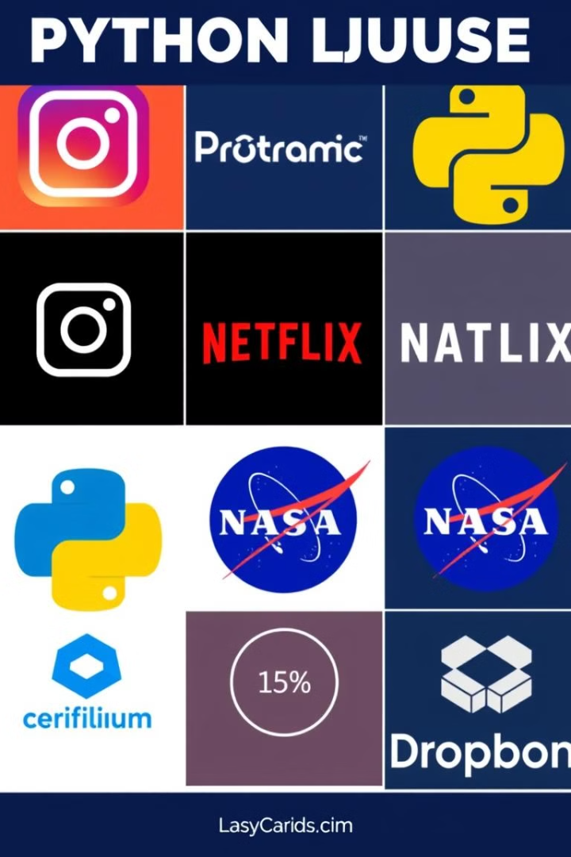




Python in Action: Real-World Applications
Web Development
Django, Flask: Instagram, Spotify
Data Science & ML
Netflix, Google.
Scripting
Dropbox, Reddit
Scientific Computing
NASA, CERN.
Python powers various applications. These include web development, data science, and scientific research. It is used in countless organizations.

Slide 6

Data Analytics with Python
Data Manipulation
Data Visualization
Pandas cleans and transforms data.
Matplotlib and Seaborn create charts.
Statistical Analysis
SciPy for modeling and testing.
Python is a key tool for data analytics. It provides libraries for cleaning, visualizing, and analyzing data.

Slide 7




Machine Learning with Python
Scikit-learn
1
TensorFlow
2
4
PyTorch
3
Keras
Python excels in machine learning. It offers libraries for building predictive models. These tools help with complex tasks.

Slide 8

Key Takeaways and Next Steps
1
Versatility
Ideal for various applications.
2
Data Science
Strong in analytics and ML.
3
Resources
Documentation, courses, forums.
Python is a versatile language. It is ideal for data analytics and machine learning. Begin your Python journey today!

